Slide 1
Chapter 15
Limits of Functions
Tyler Poppenwimer, 2019

Slide 2
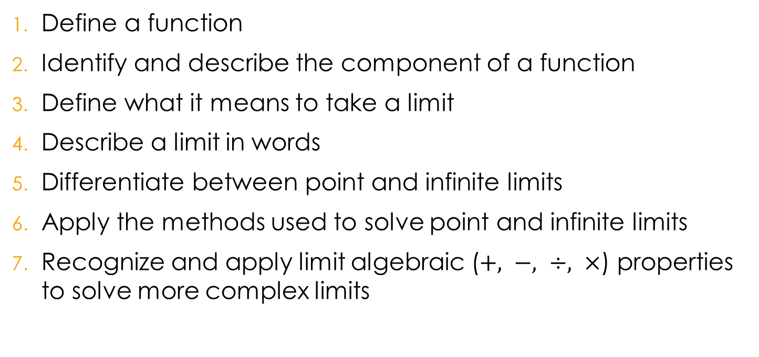
Learning Objectives
Define a function
Identify and describe the component of a function
Define what it means to take a limit
Describe a limit in words
Differentiate between point and infinite limits
Apply the methods used to solve point and infinite limits
Recognize and apply limit algebraic ($+, −, ÷, ×$) properties to solve more complex limits

Slide 3

Functions
Describe the relationship between inputs (time, temp, etc.) and outputs (population, height, etc.)
  Each day the population doubles → $f\left(t\right)=2t$

Slide 4
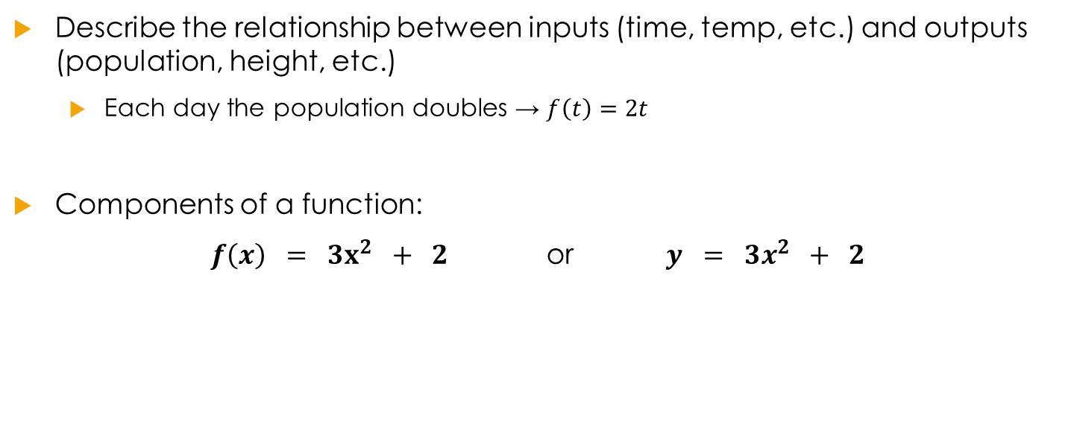
Functions
Describe the relationship between inputs (time, temp, etc.) and outputs (population, height, etc.)
  Each day the population doubles → $f\left(t\right)=2t$
Components of a function:
$f\left(x\right) = 3x^{2} + 2$ or $y = 3x^{2} + 2$

Slide 5
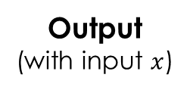
Functions
Describe the relationship between inputs (time, temp, etc.) and outputs (population, height, etc.)
  Each day the population doubles → $f\left(t\right)=2t$
Components of a function:
$f\left(x\right) = 3x^{2} + 2$ or $y = 3x^{2} + 2$
Relationship
Relationship
Output
(with input $x$)
Output

Slide 6
Functions
Describe the relationship between inputs (time, temp, etc.) and outputs (population, height, etc.)
  Each day the population doubles → $f\left(t\right)=2t$
Components of a function:
$f\left(x\right) = 3x^{2} + 2$ or $y = 3x^{2} + 2$
Output
(with input $x$)
Output

Slide 7



Limits of a Function
Limit:
$$\lim_{x→a}{f\left(x\right)=L}$$
$$f(x)$$
$$a$$

Slide 8

Limits of a Function
Limit:
$$\lim_{x→a}{f\left(x\right)=L}$$
Read as “the limit of $f(x)$as $x$ approaches $a$ is equal to $L$”
$$f(x)$$
$$a$$

Slide 9
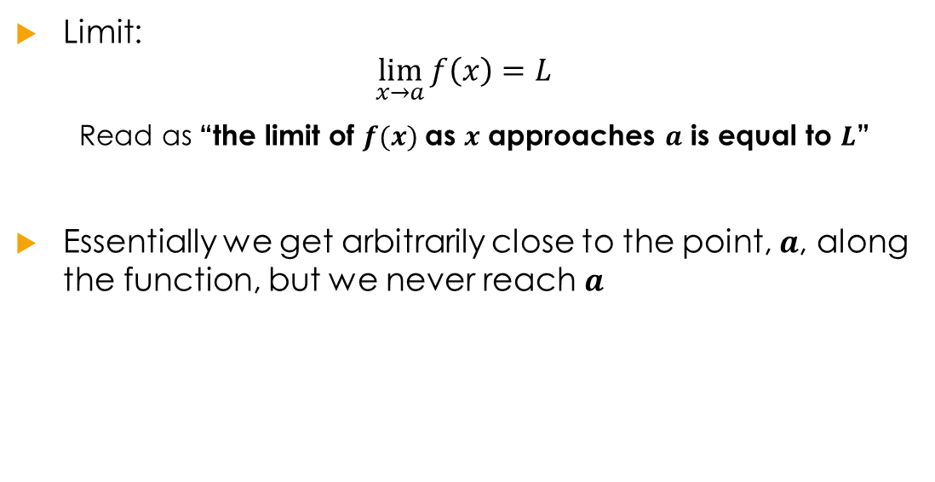
Limits of a Function
Limit:
$$\lim_{x→a}{f\left(x\right)=L}$$
Read as “the limit of $f(x)$as $x$ approaches $a$ is equal to $L$”
Essentially we get arbitrarily close to the point, $a$, along the function, but we never reach $a$
$$f(x)$$
$$a$$

Slide 10




Limits of a Function
Limit:
$$\lim_{x→a}{f\left(x\right)=L}$$
Read as “the limit of $f(x)$as $x$ approaches $a$ is equal to $L$”
Essentially we get arbitrarily close to the point, $a$, along the function, but we never reach $a$
$$f(x)$$
$$a$$
$$f(x)$$
$$a$$
$$f(x)$$
$$a$$

Slide 11
Limits of a Function
How do we find limits?

Slide 12


Limits of a Function
$$f\left(x\right)={−x}^{3}+2x$$
How do we find limits?
$$\lim_{x→0}{f(x)}$$

Slide 13

Limits of a Function
$$f\left(x\right)={−x}^{3}+2x$$
How do we find limits?
Often we can find limits by plugging in $a$ for the x value.

Slide 14
Limits of a Function
$$f\left(x\right)={−x}^{3}+2x$$
How do we find limits?
Often we can find limits by plugging in $a$ for the x value.
$$\lim_{x→0}{f(x)}$$

Slide 15

Limits of a Function
$$f\left(x\right)={−x}^{3}+2x$$
How do we find limits?
Often we can find limits by plugging in $a$ for the x value.
$$\lim_{x→0}{f(x)}$$
$$f\left(0\right)={−(0)}^{3}+2\left(0\right) = 0$$

Slide 16

Limits of a Function
$$f\left(x\right)={−x}^{3}+2x$$
How do we find limits?
Often we can find limits by plugging in $a$ for the x value.
$$\lim_{x→0}{f(x)}$$
$$f\left(0\right)={−(0)}^{3}+2\left(0\right) = 0$$
$$\lim_{x→0}{f\left(x\right)= 0}$$

Slide 17

Solving Limits
Simply plug in
$$\lim_{x→a}{f\left(x\right)}=f(a)$$

Slide 18

Solving Limits
Simply plug in
$$\lim_{x→a}{f\left(x\right)}=f(a)$$
$$f\left(x\right)=3x^{2}−2x, a=2$$
$$\lim_{x→2}{f\left(x\right)}=3{\left(2\right)}^{2}−2\left(2\right)=8$$
$$\lim_{x→2}{f\left(x\right)}=8$$

Slide 19

Solving Limits
Simply plug in
$$\lim_{x→a}{f\left(x\right)}=f(a)$$
$$f\left(x\right)=3x^{2}−2x, a=2$$
$$\lim_{x→2}{f\left(x\right)}=3{\left(2\right)}^{2}−2\left(2\right)=8$$
$$\lim_{x→2}{f\left(x\right)}=8$$

Slide 20
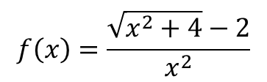
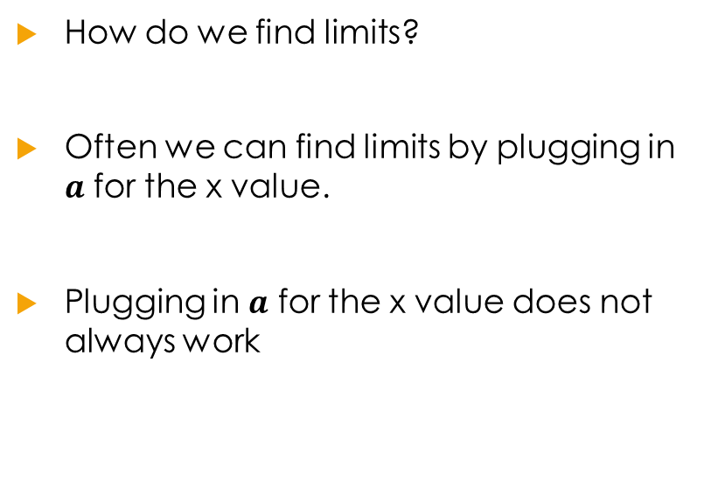

Limits of a Function
$$f\left(x\right)=\frac{\sqrt{x^{2}+4}−2}{x^{2}}$$
How do we find limits?
Often we can find limits by plugging in $a$ for the x value.
Plugging in $a$ for the x value does not always work
$$\lim_{x→0}{f(x)}$$

Slide 21
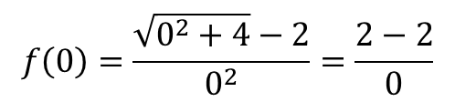
Limits of a Function
$$f\left(x\right)=\frac{\sqrt{x^{2}+4}−2}{x^{2}}$$
How do we find limits?
Often we can find limits by plugging in $a$ for the x value.
Plugging in $a$ for the x value does not always work
$$\lim_{x→0}{f(x)}$$
$$f\left(0\right)=\frac{\sqrt{0^{2}+4}−2}{0^{2}}=\frac{2−2}{0}$$

Slide 22
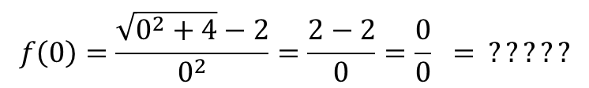
Limits of a Function
$$f\left(x\right)=\frac{\sqrt{x^{2}+4}−2}{x^{2}}$$
How do we find limits?
Often we can find limits by plugging in $a$ for the x value.
Plugging in $a$ for the x value does not always work
$$\lim_{x→0}{f(x)}$$
$$f\left(0\right)=\frac{\sqrt{0^{2}+4}−2}{0^{2}}=\frac{2−2}{0}=\frac{0}{0} = ?????$$

Slide 23

Limits of a Function
$$f\left(x\right)=\frac{\sqrt{x^{2}+4}−2}{x^{2}}$$
How do we find limits?
Often we can find limits by plugging in $a$ for the x value.
Plugging in $a$ for the x value does not always work
$$\lim_{x→0}{f(x)}$$
$$f\left(0\right)=\frac{\sqrt{0^{2}+4}−2}{0^{2}}=\frac{2−2}{0}=\frac{0}{0} = ?????$$
$\lim_{x→0}{f(x)} = ?undefined?$

Slide 24

Solving Limits
Indeterminate Expressions
Sometimes plugging in doesn’t work
It doesn’t work when you have these expressions
$$\frac{∞}{∞}$$ | $$\frac{0}{0}$$ | $$\frac{anything}{0}$$ | $$∞−∞$$ | $$∞×0$$ | $$0^{0}$$ | $$∞^{0}$$ | $$1^{∞}$$
$$f\left(x\right)=\frac{x^{2}−4}{x−2} , a=2$$
$$\lim_{x→2}{f\left(x\right)}=\frac{{\left(2\right)}^{2}−4}{2−2}=\frac{0}{0}$$

Slide 25
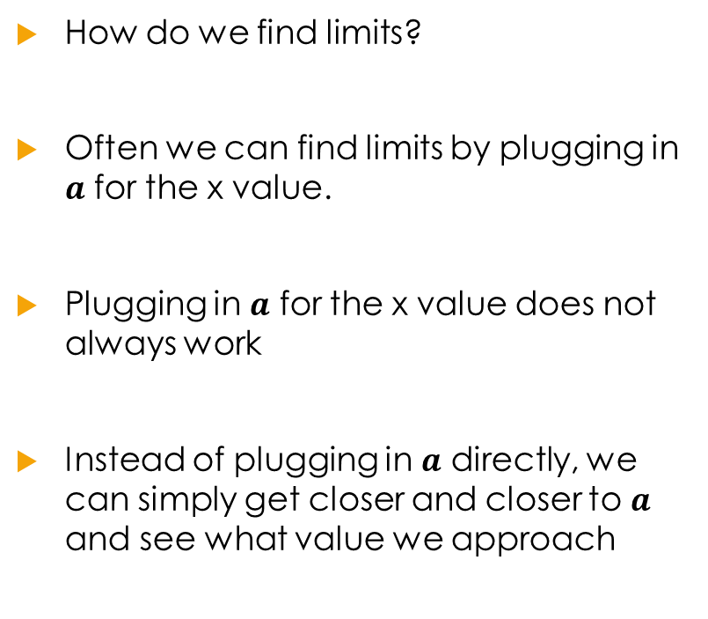
Limits of a Function
$$f\left(x\right)=\frac{\sqrt{x^{2}+4}−2}{x^{2}}$$
How do we find limits?
Often we can find limits by plugging in $a$ for the x value.
Plugging in $a$ for the x value does not always work
Instead of plugging in $a$ directly, we can simply get closer and closer to $a$ and see what value we approach
$$\lim_{x→0}{f(x)}$$

Slide 26
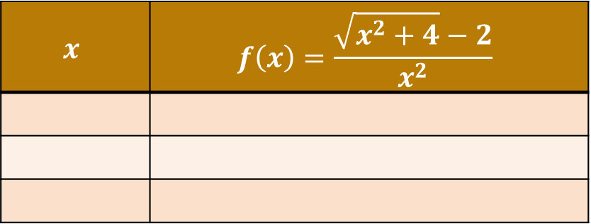
Limits of a Function
$$f\left(x\right)=\frac{\sqrt{x^{2}+4}−2}{x^{2}}$$
How do we find limits?
Often we can find limits by plugging in $a$ for the x value.
Plugging in $a$ for the x value does not always work
Instead of plugging in $a$ directly, we can simply get closer and closer to $a$ and see what value we approach
$$\lim_{x→0}{f(x)}$$
$$x$$ | $$f\left(x\right)=\frac{\sqrt{x^{2}+4}−2}{x^{2}}$$

Slide 27
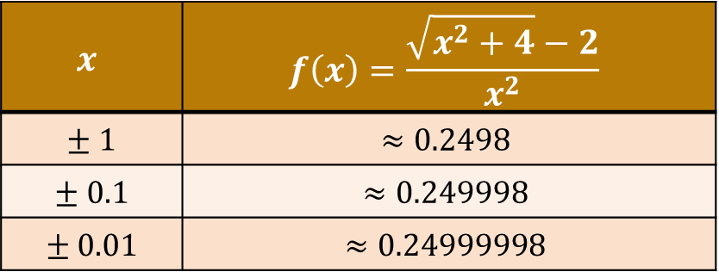
Limits of a Function
$$f\left(x\right)=\frac{\sqrt{x^{2}+4}−2}{x^{2}}$$
How do we find limits?
Often we can find limits by plugging in $a$ for the x value.
Plugging in $a$ for the x value does not always work
Instead of plugging in $a$ directly, we can simply get closer and closer to $a$ and see what value we approach
$$\lim_{x→0}{f(x)}$$
$$x$$ | $$f\left(x\right)=\frac{\sqrt{x^{2}+4}−2}{x^{2}}$$
$$± 1$$ | $$≈0.2498$$
$$± 0.1$$ | $$≈0.249998$$
$$± 0.01$$ | $$≈0.24999998$$

Slide 28
Solving Limits
Plug in | Factor | Common Denominator | Rationalize
Normal Functions | Polynomials fractions | Adding or Subtracting Fractions | Square roots

Slide 29
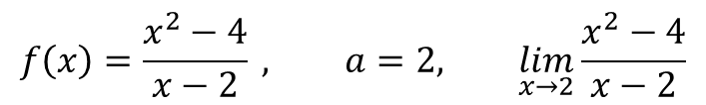
Solving Limits
Factor
$$f\left(x\right)=\frac{x^{2}−4}{x−2} , a=2, \lim_{x→2}{\frac{x^{2}−4}{x−2}}$$

Slide 30
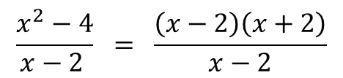
Solving Limits
Factor
$$f\left(x\right)=\frac{x^{2}−4}{x−2} , a=2, \lim_{x→2}{\frac{x^{2}−4}{x−2}}$$
$$\frac{x^{2}−4}{x−2 } = \frac{\left(x−2\right)\left(x+2\right)}{x−2}$$
Factor

Slide 31
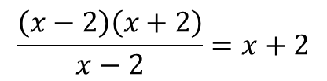
Solving Limits
Factor
$$f\left(x\right)=\frac{x^{2}−4}{x−2} , a=2, \lim_{x→2}{\frac{x^{2}−4}{x−2}}$$
$$\frac{x^{2}−4}{x−2 } = \frac{\left(x−2\right)\left(x+2\right)}{x−2}$$
Factor
$$\frac{\left(x−2\right)\left(x+2\right)}{x−2}=x+2$$
Cancel

Slide 32

Solving Limits
Factor
$$f\left(x\right)=\frac{x^{2}−4}{x−2} , a=2, \lim_{x→2}{\frac{x^{2}−4}{x−2}}$$
$$\frac{x^{2}−4}{x−2 } = \frac{\left(x−2\right)\left(x+2\right)}{x−2}$$
Factor
This is only true when x does not equal 2
$$\frac{\left(x−2\right)\left(x+2\right)}{x−2}=x+2$$
Cancel
$$for x≠2$$

Slide 33

Solving Limits
Factor
$$f\left(x\right)=\frac{x^{2}−4}{x−2} , a=2, \lim_{x→2}{\frac{x^{2}−4}{x−2}}$$
$$\frac{x^{2}−4}{x−2 } = \frac{\left(x−2\right)\left(x+2\right)}{x−2}$$
Factor
This is only true when x does not equal 2
$$\frac{\left(x−2\right)\left(x+2\right)}{x−2}=x+2$$
Cancel
$$for x≠2$$
Plug in
$$x+2 = 2+2 = 4$$

Slide 34
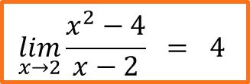
Solving Limits
Factor
$$f\left(x\right)=\frac{x^{2}−4}{x−2} , a=2, \lim_{x→2}{\frac{x^{2}−4}{x−2}}$$
$$\frac{x^{2}−4}{x−2 } = \frac{\left(x−2\right)\left(x+2\right)}{x−2}$$
Factor
This is only true when x does not equal 2
$$\frac{\left(x−2\right)\left(x+2\right)}{x−2}=x+2$$
Cancel
$$for x≠2$$
Plug in
$$x+2 = 2+2 = 4$$
$$\lim_{x→2}{\frac{x^{2}−4}{x−2}} = 4$$

Slide 35
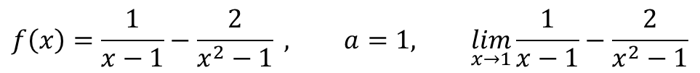
Solving Limits
Find a Common Denominator
$$f\left(x\right)=\frac{1}{x−1}−\frac{2}{x^{2}−1} , a=1, \lim_{x→1}{\frac{1}{x−1}−\frac{2}{x^{2}−1}}$$

Slide 36
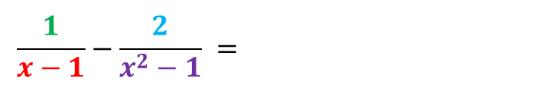
Solving Limits
Find a Common Denominator
$$f\left(x\right)=\frac{1}{x−1}−\frac{2}{x^{2}−1} , a=1, \lim_{x→1}{\frac{1}{x−1}−\frac{2}{x^{2}−1}}$$
Find Common Denominator
$$\frac{1}{x−1}−\frac{2}{x^{2}−1} = \frac{1\left(x^{2}−1\right)−2\left(x−1\right)}{\left(x−1\right)\left(x^{2}−1\right)}$$

Slide 37
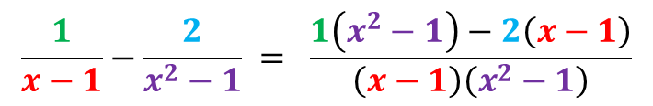
Solving Limits
Find a Common Denominator
$$f\left(x\right)=\frac{1}{x−1}−\frac{2}{x^{2}−1} , a=1, \lim_{x→1}{\frac{1}{x−1}−\frac{2}{x^{2}−1}}$$
Find Common Denominator
$$\frac{1}{x−1}−\frac{2}{x^{2}−1} = \frac{1\left(x^{2}−1\right)−2\left(x−1\right)}{\left(x−1\right)\left(x^{2}−1\right)}$$

Slide 38
Solving Limits
Find a Common Denominator
$$f\left(x\right)=\frac{1}{x−1}−\frac{2}{x^{2}−1} , a=1, \lim_{x→1}{\frac{1}{x−1}−\frac{2}{x^{2}−1}}$$
Find Common Denominator
$$\frac{1}{x−1}−\frac{2}{x^{2}−1} = \frac{1\left(x^{2}−1\right)−2\left(x−1\right)}{\left(x−1\right)\left(x^{2}−1\right)}$$
Combine like terms and factor
$$\frac{x^{2}−2x+1}{\left(x−1\right)\left[\left(x−1\right)\left(x+1\right)\right] } = \frac{x^{2}−2x+1}{\left(x−1\right)\left(x−1\right)\left(x+1\right)} = \frac{\left(x−1\right)\left(x−1\right)}{{\left(x−1\right)}^{2}(x+1)}$$

Slide 39
Solving Limits
Find a Common Denominator
$$f\left(x\right)=\frac{1}{x−1}−\frac{2}{x^{2}−1} , a=1, \lim_{x→1}{\frac{1}{x−1}−\frac{2}{x^{2}−1}}$$
Find Common Denominator
$$\frac{1}{x−1}−\frac{2}{x^{2}−1} = \frac{1\left(x^{2}−1\right)−2\left(x−1\right)}{\left(x−1\right)\left(x^{2}−1\right)}$$
Combine like terms and factor
$$\frac{x^{2}−2x+1}{\left(x−1\right)\left[\left(x−1\right)\left(x+1\right)\right] } = \frac{x^{2}−2x+1}{\left(x−1\right)\left(x−1\right)\left(x+1\right)} = \frac{\left(x−1\right)\left(x−1\right)}{{\left(x−1\right)}^{2}(x+1)}$$

Slide 40
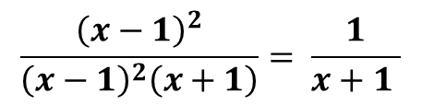

Solving Limits
Find a Common Denominator
$$f\left(x\right)=\frac{1}{x−1}−\frac{2}{x^{2}−1} , a=1, \lim_{x→1}{\frac{1}{x−1}−\frac{2}{x^{2}−1}}$$
Find Common Denominator
$$\frac{1}{x−1}−\frac{2}{x^{2}−1} = \frac{1\left(x^{2}−1\right)−2\left(x−1\right)}{\left(x−1\right)\left(x^{2}−1\right)}$$
Combine like terms and factor
$$\frac{x^{2}−2x+1}{\left(x−1\right)\left[\left(x−1\right)\left(x+1\right)\right] } = \frac{x^{2}−2x+1}{\left(x−1\right)\left(x−1\right)\left(x+1\right)} = \frac{\left(x−1\right)\left(x−1\right)}{{\left(x−1\right)}^{2}(x+1)}$$
$$\frac{{\left(x−1\right)}^{2}}{{\left(x−1\right)}^{2}\left(x+1\right)}= \frac{1}{x+1 }$$
Cancel
$$for x≠1$$

Slide 41
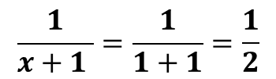
Solving Limits
Find a Common Denominator
$$f\left(x\right)=\frac{1}{x−1}−\frac{2}{x^{2}−1} , a=1, \lim_{x→1}{\frac{1}{x−1}−\frac{2}{x^{2}−1}}$$
Find Common Denominator
$$\frac{1}{x−1}−\frac{2}{x^{2}−1} = \frac{1\left(x^{2}−1\right)−2\left(x−1\right)}{\left(x−1\right)\left(x^{2}−1\right)}$$
Combine like terms and factor
$$\frac{x^{2}−2x+1}{\left(x−1\right)\left[\left(x−1\right)\left(x+1\right)\right] } = \frac{x^{2}−2x+1}{\left(x−1\right)\left(x−1\right)\left(x+1\right)} = \frac{\left(x−1\right)\left(x−1\right)}{{\left(x−1\right)}^{2}(x+1)}$$
$$\frac{{\left(x−1\right)}^{2}}{{\left(x−1\right)}^{2}\left(x+1\right)}= \frac{1}{x+1 }$$
Cancel
$$for x≠1$$
$$\frac{1}{x+1 }=\frac{1}{1+1}=\frac{1}{2}$$
Plug in

Slide 42
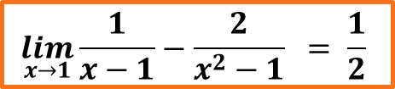
Solving Limits
Find a Common Denominator
$$f\left(x\right)=\frac{1}{x−1}−\frac{2}{x^{2}−1} , a=1, \lim_{x→1}{\frac{1}{x−1}−\frac{2}{x^{2}−1}}$$
Find Common Denominator
$$\frac{1}{x−1}−\frac{2}{x^{2}−1} = \frac{1\left(x^{2}−1\right)−2\left(x−1\right)}{\left(x−1\right)\left(x^{2}−1\right)}$$
Combine like terms and factor
$$\frac{x^{2}−2x+1}{\left(x−1\right)\left[\left(x−1\right)\left(x+1\right)\right] } = \frac{x^{2}−2x+1}{\left(x−1\right)\left(x−1\right)\left(x+1\right)} = \frac{\left(x−1\right)\left(x−1\right)}{{\left(x−1\right)}^{2}(x+1)}$$
$$\frac{{\left(x−1\right)}^{2}}{{\left(x−1\right)}^{2}\left(x+1\right)}= \frac{1}{x+1 }$$
Cancel
$$for x≠1$$
$$\frac{1}{x+1 }=\frac{1}{1+1}=\frac{1}{2}$$
$$\lim_{x→1}{\frac{1}{x−1}−\frac{2}{x^{2}−1}} = \frac{1}{2}$$
Plug in

Slide 43
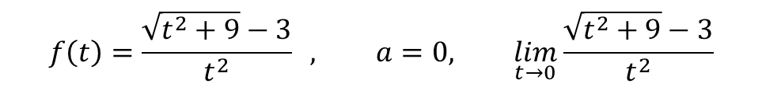
Solving Limits
Rationalization
$$f\left(t\right)=\frac{\sqrt{t^{2}+9}−3}{t^{2}} , a=0, \lim_{t→0}{\frac{\sqrt{t^{2}+9}−3}{t^{2}}}$$

Slide 44
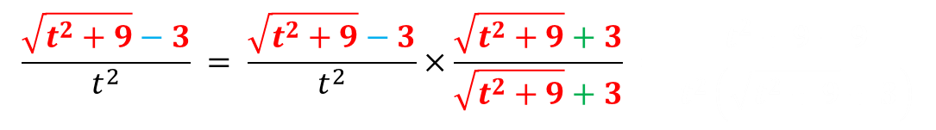
Solving Limits
Rationalization
$$f\left(t\right)=\frac{\sqrt{t^{2}+9}−3}{t^{2}} , a=0, \lim_{t→0}{\frac{\sqrt{t^{2}+9}−3}{t^{2}}}$$
Rationalize
$$\frac{\sqrt{t^{2}+9}−3}{t^{2}} = \frac{\sqrt{t^{2}+9}−3}{t^{2}}×\frac{\sqrt{t^{2}+9}+3}{\sqrt{t^{2}+9}+3} = \frac{t^{2}+9−9}{t^{2}\left(\sqrt{t^{2}+9}+3\right)}$$

Slide 45
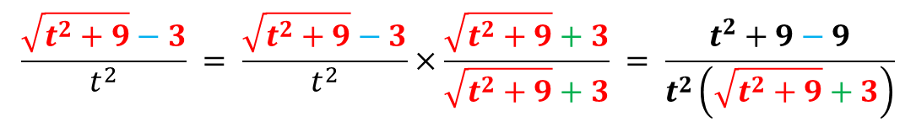
Solving Limits
Rationalization
$$f\left(t\right)=\frac{\sqrt{t^{2}+9}−3}{t^{2}} , a=0, \lim_{t→0}{\frac{\sqrt{t^{2}+9}−3}{t^{2}}}$$
Rationalize
$$\frac{\sqrt{t^{2}+9}−3}{t^{2}} = \frac{\sqrt{t^{2}+9}−3}{t^{2}}×\frac{\sqrt{t^{2}+9}+3}{\sqrt{t^{2}+9}+3} = \frac{t^{2}+9−9}{t^{2}\left(\sqrt{t^{2}+9}+3\right)}$$

Slide 46
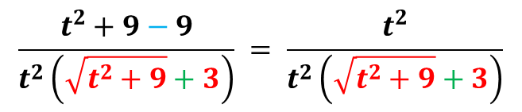
Solving Limits
Rationalization
$$f\left(t\right)=\frac{\sqrt{t^{2}+9}−3}{t^{2}} , a=0, \lim_{t→0}{\frac{\sqrt{t^{2}+9}−3}{t^{2}}}$$
Rationalize
$$\frac{\sqrt{t^{2}+9}−3}{t^{2}} = \frac{\sqrt{t^{2}+9}−3}{t^{2}}×\frac{\sqrt{t^{2}+9}+3}{\sqrt{t^{2}+9}+3} = \frac{t^{2}+9−9}{t^{2}\left(\sqrt{t^{2}+9}+3\right)}$$
Combine like terms
$$\frac{t^{2}+9−9}{t^{2}\left(\sqrt{t^{2}+9}+3\right)} = \frac{t^{2}}{t^{2}\left(\sqrt{t^{2}+9}+3\right)}$$

Slide 47
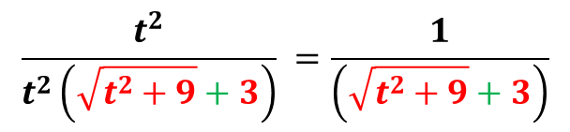
Solving Limits
Rationalization
$$f\left(t\right)=\frac{\sqrt{t^{2}+9}−3}{t^{2}} , a=0, \lim_{t→0}{\frac{\sqrt{t^{2}+9}−3}{t^{2}}}$$
Rationalize
$$\frac{\sqrt{t^{2}+9}−3}{t^{2}} = \frac{\sqrt{t^{2}+9}−3}{t^{2}}×\frac{\sqrt{t^{2}+9}+3}{\sqrt{t^{2}+9}+3} = \frac{t^{2}+9−9}{t^{2}\left(\sqrt{t^{2}+9}+3\right)}$$
Combine like terms
$$\frac{t^{2}+9−9}{t^{2}\left(\sqrt{t^{2}+9}+3\right)} = \frac{t^{2}}{t^{2}\left(\sqrt{t^{2}+9}+3\right)}$$
$$\frac{t^{2}}{t^{2}\left(\sqrt{t^{2}+9}+3\right)} =\frac{1}{\left(\sqrt{t^{2}+9}+3\right)}$$
Cancel

Slide 48
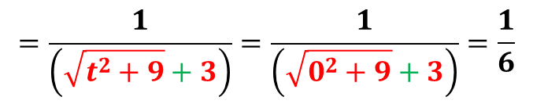
Solving Limits
Rationalization
$$f\left(t\right)=\frac{\sqrt{t^{2}+9}−3}{t^{2}} , a=0, \lim_{t→0}{\frac{\sqrt{t^{2}+9}−3}{t^{2}}}$$
Rationalize
$$\frac{\sqrt{t^{2}+9}−3}{t^{2}} = \frac{\sqrt{t^{2}+9}−3}{t^{2}}×\frac{\sqrt{t^{2}+9}+3}{\sqrt{t^{2}+9}+3} = \frac{t^{2}+9−9}{t^{2}\left(\sqrt{t^{2}+9}+3\right)}$$
Combine like terms
$$\frac{t^{2}+9−9}{t^{2}\left(\sqrt{t^{2}+9}+3\right)} = \frac{t^{2}}{t^{2}\left(\sqrt{t^{2}+9}+3\right)}$$
$$\frac{t^{2}}{t^{2}\left(\sqrt{t^{2}+9}+3\right)} =\frac{1}{\left(\sqrt{t^{2}+9}+3\right)}$$
Cancel
$$=\frac{1}{\left(\sqrt{t^{2}+9}+3\right)}=\frac{1}{\left(\sqrt{0^{2}+9}+3\right)}=\frac{1}{6}$$
Plug in

Slide 49
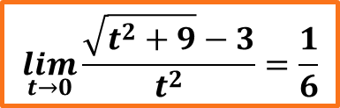
Solving Limits
Rationalization
$$f\left(t\right)=\frac{\sqrt{t^{2}+9}−3}{t^{2}} , a=0, \lim_{t→0}{\frac{\sqrt{t^{2}+9}−3}{t^{2}}}$$
Rationalize
$$\frac{\sqrt{t^{2}+9}−3}{t^{2}} = \frac{\sqrt{t^{2}+9}−3}{t^{2}}×\frac{\sqrt{t^{2}+9}+3}{\sqrt{t^{2}+9}+3} = \frac{t^{2}+9−9}{t^{2}\left(\sqrt{t^{2}+9}+3\right)}$$
Combine like terms
$$\frac{t^{2}+9−9}{t^{2}\left(\sqrt{t^{2}+9}+3\right)} = \frac{t^{2}}{t^{2}\left(\sqrt{t^{2}+9}+3\right)}$$
$$\frac{t^{2}}{t^{2}\left(\sqrt{t^{2}+9}+3\right)} =\frac{1}{\left(\sqrt{t^{2}+9}+3\right)}$$
Cancel
$$=\frac{1}{\left(\sqrt{t^{2}+9}+3\right)}=\frac{1}{\left(\sqrt{0^{2}+9}+3\right)}=\frac{1}{6}$$
$$\lim_{t→0}{\frac{\sqrt{t^{2}+9}−3}{t^{2}}=\frac{1}{6}}$$
Plug in

Slide 50
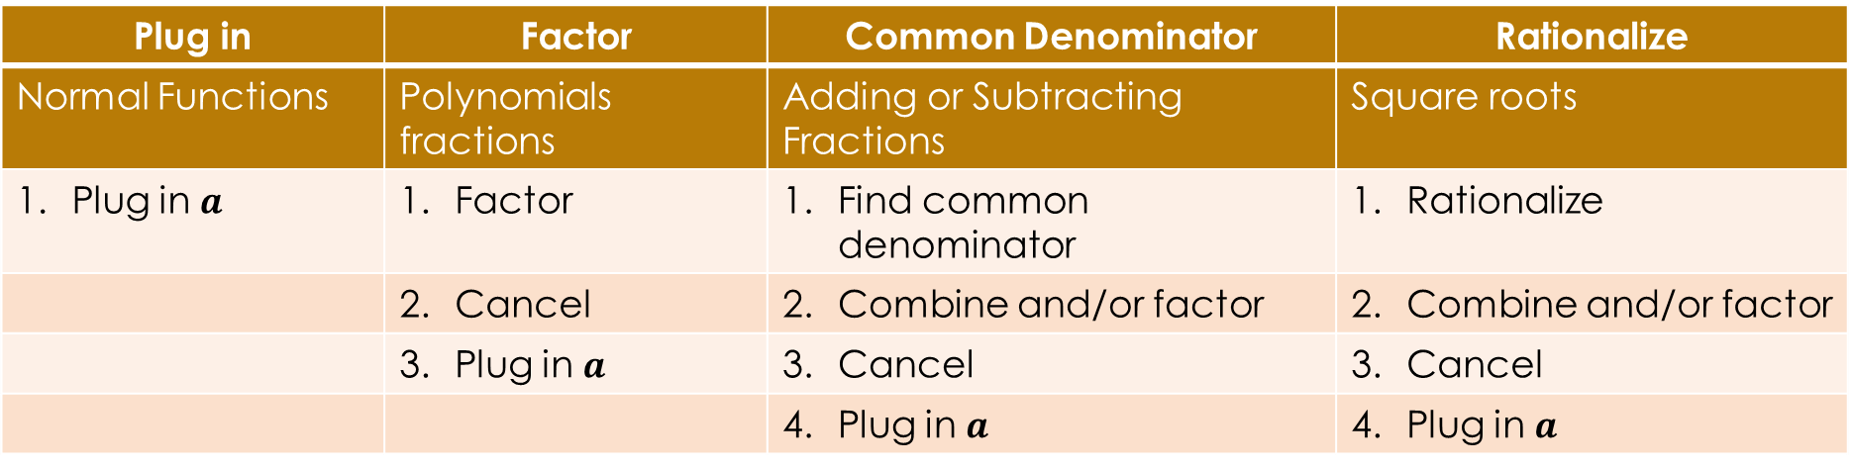
Solving Limits
Plug in | Factor | Common Denominator | Rationalize
Normal Functions | Polynomials fractions | Adding or Subtracting Fractions | Square roots
Plug in $a$ | Factor | Find common denominator | Rationalize
 | Cancel | Combine and/or factor | Combine and/or factor
 | Plug in $a$ | Cancel | Cancel
 |  | Plug in $a$ | Plug in $a$

Slide 51
Solving Limits
Plug in | Factor | Common Denominator | Rationalize
Normal Functions | Polynomials fractions | Adding or Subtracting Fractions | Square roots
Plug in $a$ | Factor | Find common denominator | Rationalize
 | Cancel | Combine and/or factor | Combine and/or factor
 | Plug in $a$ | Cancel | Cancel
 |  | Plug in $a$ | Plug in $a$
Functions may require a combination of methods to solve

Slide 52
Solving Limits
Approaching Infinity and Negative Infinity
For powers and exponents, there are two easy rules
For others, find the largest power of the variable, this part will dominate
If two powers are the same, ignore the variables and all numbers associated with it
If all else fails, plug in a large number

Slide 53
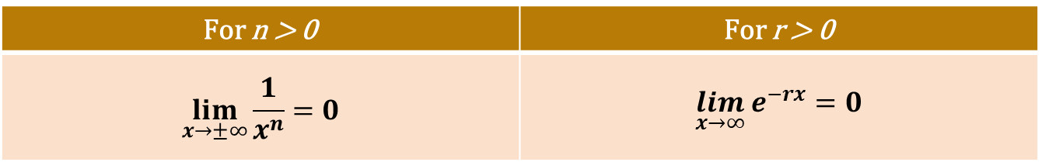
Solving Limits
Approaching Infinity and Negative Infinity
  Powers and Exponents
For n > 0 | For r > 0
$$\lim_{x→±∞}{\frac{1}{x^{n}}}=0$$ | $$\lim_{x→∞}{e^{−rx}}=0$$

Slide 54
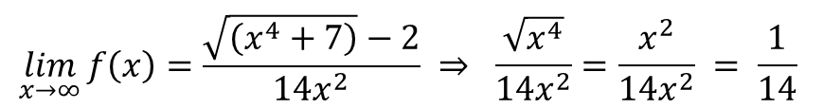
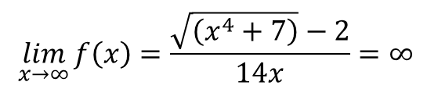
Solving Limits
Approaching Infinity and Negative Infinity
  Non exponential or power
Find the largest power of the variable, this part will dominate
If two powers are the same, ignore the variables and all numbers associated with it
If all else fails, plug in a large number
Largest power dominates
Same powers
$$\lim_{x→∞}{f\left(x\right)}=\frac{\sqrt{\left(x^{4}+7\right)}−2}{14x}=∞$$
$$\lim_{x→∞}{f\left(x\right)}=\frac{\sqrt{\left(x^{4}+7\right)}−2}{14x^{2}} ⇒ \frac{\sqrt{x^{4}}}{14x^{2}}=\frac{x^{2}}{14x^{2}} = \frac{1}{14}$$

Slide 55
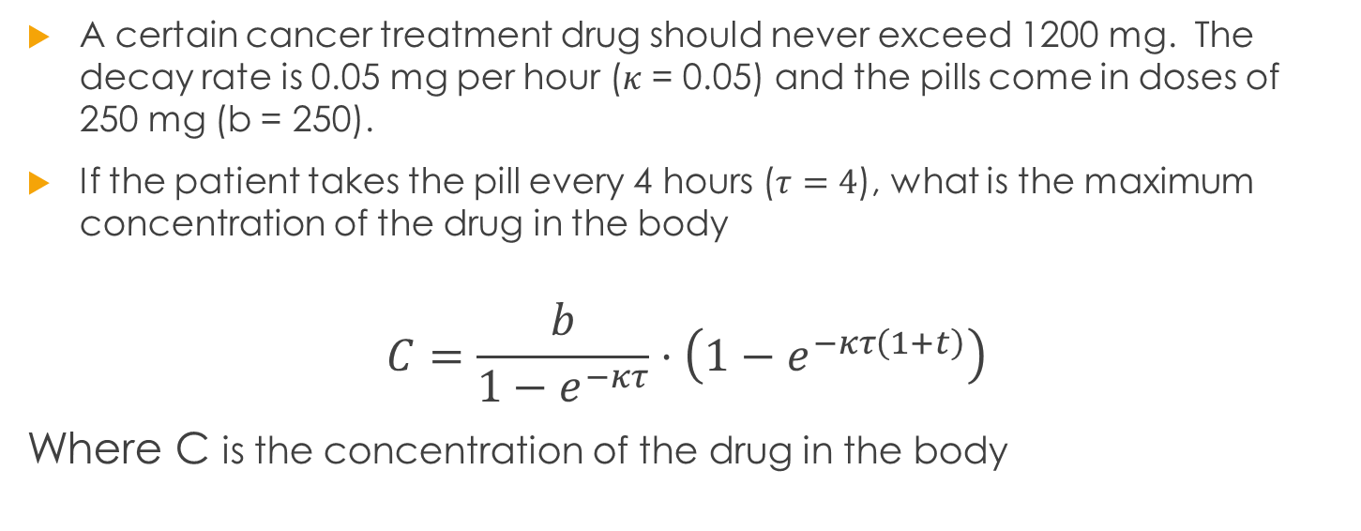
Word Problem
A certain cancer treatment drug should never exceed 1200 mg. The decay rate is 0.05 mg per hour ($κ$ = 0.05) and the pills come in doses of 250 mg (b = 250).
If the patient takes the pill every 4 hours ($τ=4$), what is the maximum concentration of the drug in the body
$$C=\frac{b}{1−e^{−κτ}}⋅\left(1−e^{−κτ\left(1+t\right)}\right)$$
Where C is the concentration of the drug in the body

Slide 56
Word Problem
A certain cancer treatment drug should never exceed 1200 mg. The decay rate is 0.05 mg per hour ($κ$ = 0.05) and the pills come in doses of 250 mg (b = 250).
If the patient takes the pill every 4 hours ($τ=4$), what is the maximum concentration of the drug in the body
$$C=\frac{b}{1−e^{−κτ}}⋅\left(1−e^{−κτ\left(1+t\right)}\right)$$
Where C is the concentration of the drug in the body
Q1 A: What is the ultimate concentration of the drug in the body?

Slide 57
Word Problem
A certain cancer treatment drug should never exceed 1200 mg. The decay rate is 0.05 mg per hour ($κ$ = 0.05) and the pills come in doses of 250 mg (b = 250).
If the patient takes the pill every 4 hours ($τ=4$), what is the maximum concentration of the drug in the body
$$C=\frac{b}{1−e^{−κτ}}⋅\left(1−e^{−κτ\left(1+t\right)}\right)$$
Where C is the concentration of the drug in the body
Q1 B: Does the ultimate concentration of the drug surpass the 1200 mg safety threshold?

Slide 58
Word Problem
A certain cancer treatment drug should never exceed 1200 mg. The decay rate is 0.05 mg per hour ($κ$ = 0.05) and the pills come in doses of 250 mg (b = 250).
If the patient takes the pill every 4 hours ($τ=4$), what is the maximum concentration of the drug in the body
$$C=\frac{b}{1−e^{−κτ}}⋅\left(1−e^{−κτ\left(1+t\right)}\right)$$
Where C is the concentration of the drug in the body
Q2: How often should the patient take the drug to keep the max concentration at roughly 1200 mg?

Slide 59
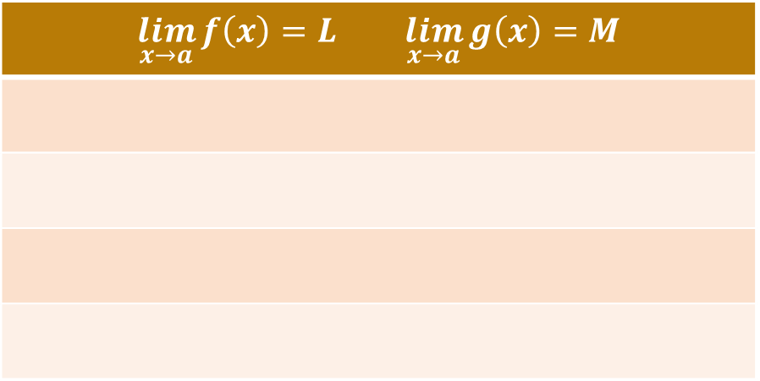
Limits Properties
Often, we are interested in a combinations of functions.
How does this affect limits?
$$\lim_{x→a}{f\left(x\right)=L}\lim_{x→a}{g\left(x\right)=M}$$

Slide 60
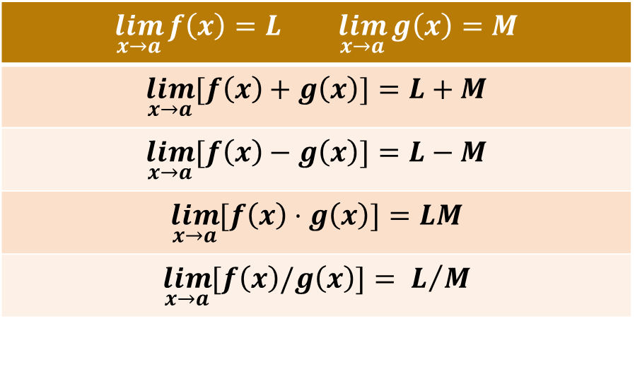
Limits Properties
Often, we are interested in a combinations of functions.
How does this affect limits?
$$\lim_{x→a}{f\left(x\right)=L}\lim_{x→a}{g\left(x\right)=M}$$
$$\lim_{x→a}{[f\left(x\right)+g\left(x\right)]}=L+M$$
$$\lim_{x→a}{[f\left(x\right)−g\left(x\right)]}=L−M$$
$$\lim_{x→a}{[f\left(x\right)⋅g\left(x\right)]}=LM$$
$$\lim_{x→a}{[f\left(x\right)/g\left(x\right)]}= L/M$$

Slide 61
Word Problem
A certain cancer treatment drug should never exceed 1200 mg. The decay rate is 0.05 mg per hour ($κ$ = 0.05) and the pills come in doses of 250 mg (b = 250).
If the patient takes the pill every 4 hours ($τ=4$), what is the maximum concentration of the drug in the body
$$C=\frac{b}{1−e^{−κτ}}⋅\left(1−e^{−κτ\left(1+t\right)}\right)$$
Where C is the concentration of the drug in the body

Slide 62
Word Problem
A certain cancer treatment drug should never exceed 1200 mg. The decay rate is 0.05 mg per hour ($κ$ = 0.05) and the pills come in doses of 250 mg (b = 250).
If the patient takes the pill every 4 hours ($τ=4$), what is the maximum concentration of the drug in the body
$$C=\frac{b}{1−e^{−κτ}}⋅\left(1−e^{−κτ\left(1+t\right)}\right)$$
Where C is the concentration of the drug in the body
Q1 A: What is the ultimate concentration of the drug in the body?

Slide 63
Word Problem
A certain cancer treatment drug should never exceed 1200 mg. The decay rate is 0.05 mg per hour ($κ$ = 0.05) and the pills come in doses of 250 mg (b = 250).
If the patient takes the pill every 4 hours ($τ=4$), what is the maximum concentration of the drug in the body
$$C=\frac{b}{1−e^{−κτ}}⋅\left(1−e^{−κτ\left(1+t\right)}\right)$$
Where C is the concentration of the drug in the body
Q1 B: Does the ultimate concentration of the drug surpass the 1200 mg safety threshold?

Slide 64
Word Problem
A certain cancer treatment drug should never exceed 1200 mg. The decay rate is 0.05 mg per hour ($κ$ = 0.05) and the pills come in doses of 250 mg (b = 250).
If the patient takes the pill every 4 hours ($τ=4$), what is the maximum concentration of the drug in the body
$$C=\frac{b}{1−e^{−κτ}}⋅\left(1−e^{−κτ\left(1+t\right)}\right)$$
Where C is the concentration of the drug in the body
Q2: How often should the patient take the drug to keep the max concentration at roughly 1200 mg?

Slide 65

Limit Examples
$$\lim_{x→2}{\frac{x+1}{x−2}}$$
$$\lim_{x→10}{\frac{\sqrt{x}−4}{x−10}}$$

Slide 66
Limit Examples
$$\lim_{x→2}{\frac{x+1}{x−2}}$$
$$\lim_{x→10}{\frac{\sqrt{x}−4}{x−10}}$$
Try to factor
Try to rationalize

Slide 67
Limit Examples
$$\lim_{x→2}{\frac{x+1}{x−2}}$$
$$\lim_{x→10}{\frac{\sqrt{x}−4}{x−10}}$$
Try to factor
Try to rationalize

Slide 68
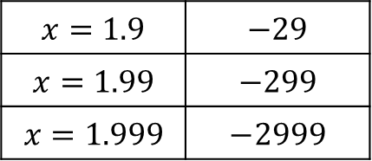
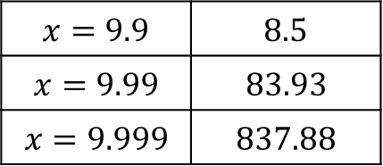
Limit Examples
$$\lim_{x→2}{\frac{x+1}{x−2}}$$
$$\lim_{x→10}{\frac{\sqrt{x}−4}{x−10}}$$
$$x=1.9$$ | $$−29$$
$$x=1.99$$ | $$−299$$
$$x=1.999$$ | $$−2999$$
Try to factor
$$x=9.9$$ | $$8.5$$
$$x=9.99$$ | $$83.93$$
$$x=9.999$$ | $$837.88$$
Try to rationalize

Slide 69
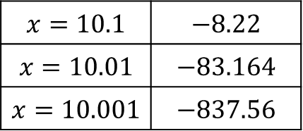
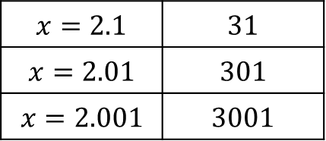
Limit Examples
$$\lim_{x→2}{\frac{x+1}{x−2}}$$
$$\lim_{x→10}{\frac{\sqrt{x}−4}{x−10}}$$
$$x=1.9$$ | $$−29$$
$$x=1.99$$ | $$−299$$
$$x=1.999$$ | $$−2999$$
$$x=2.1$$ | $$31$$
$$x=2.01$$ | $$301$$
$$x=2.001$$ | $$3001$$
Try to factor
$$x=9.9$$ | $$8.5$$
$$x=9.99$$ | $$83.93$$
$$x=9.999$$ | $$837.88$$
$$x=10.1$$ | $$−8.22$$
$$x=10.01$$ | $$−83.164$$
$$x=10.001$$ | $$−837.56$$
Try to rationalize

Slide 70

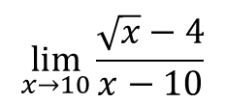
Limit Examples
$$\lim_{x→2}{\frac{x+1}{x−2}}$$
$$\lim_{x→10}{\frac{\sqrt{x}−4}{x−10}}$$

Slide 71
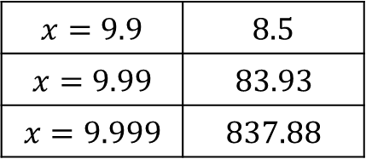



Limit Examples
$$\lim_{x→2}{\frac{x+1}{x−2}}$$
$$\lim_{x→10}{\frac{\sqrt{x}−4}{x−10}}$$
$$x=1.9$$ | $$−29$$
$$x=1.99$$ | $$−299$$
$$x=1.999$$ | $$−2999$$
$$x=9.9$$ | $$8.5$$
$$x=9.99$$ | $$83.93$$
$$x=9.999$$ | $$837.88$$
$$x=2.1$$ | $$31$$
$$x=2.01$$ | $$301$$
$$x=2.001$$ | $$3001$$
$$x=10.1$$ | $$−8.22$$
$$x=10.01$$ | $$−83.164$$
$$x=10.001$$ | $$−837.56$$

